Slide 1
Welcome to…
Seoul Residence
Your Home Away From Home.
708-16 Yeoksam-Dong Gangnam-Gu, Seoul, Korea (135-080) Tel: 02-6202-3100 Fax: 02-6202-3669 www.seoulresidence.co.kr

Slide 2
Introduction
Seoul Residence is the finest serviced residence that offers environment-friendly facilities, high-technology security system, and perfect infrastructure to manage your trip.
Seoul Residence is conveniently located in the heart of Taeheran Road, close to Gangnam business district and entertainment and shopping complex.
708-16 Yeoksam-Dong Gangnam-Gu, Seoul, Korea (135-080) Tel: 02-6202-3100 Fax: 02-6202-3669 www.seoulresidence.co.kr

Slide 3
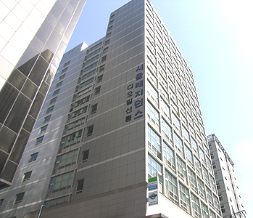
Home Away From Home
The “Hotel-like Home” atmosphere with fully equipped kitchen and other amenities will make your stay more comfortable and enjoyable.
Offering quality service and pleasant accommodation, Seoul Residence Hotel is an ideal place to reside for business or leisure travelers. This will be your home away from home.
708-16 Yeoksam-Dong Gangnam-Gu, Seoul, Korea (135-080) Tel: 02-6202-3100 Fax: 02-6202-3669 www.seoulresidence.co.kr

Slide 4
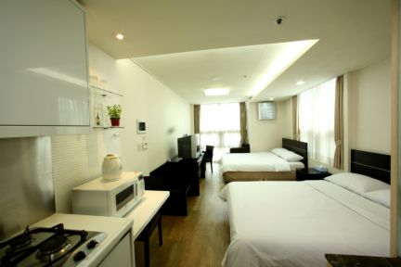
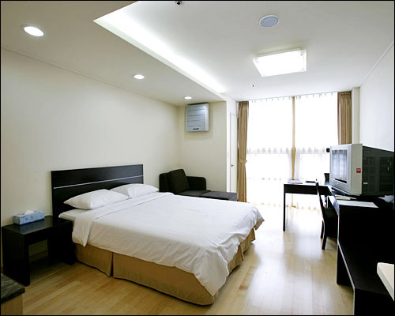
Room Type
Studio Double (Max. 2people)
Size 52.892 m²
1 Double Bed
Studio Twin (Max. 2people)
Size 52.892 m²
2 Single Beds
Studio Triple (Max. 3people)
Size 52.892 m²
1 Single Bed + 1 Double Bed
Studio Deluxe (Max. 4people)
Size 59.504m²
2 Double Beds
708-16 Yeoksam-Dong Gangnam-Gu, Seoul, Korea (135-080) Tel: 02-6202-3100 Fax: 02-6202-3669 www.seoulresidence.co.kr

Slide 5
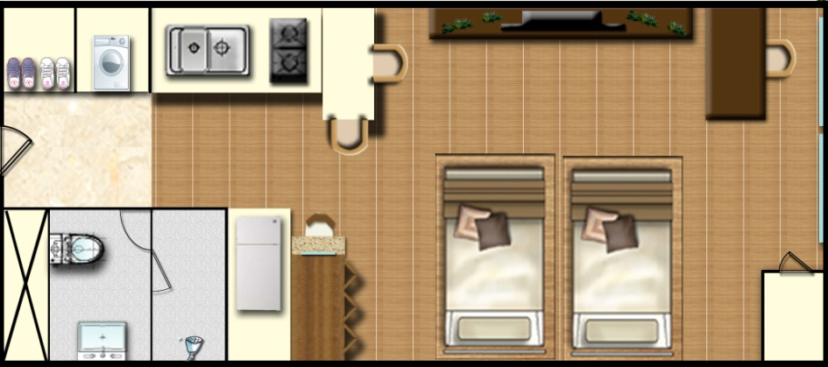
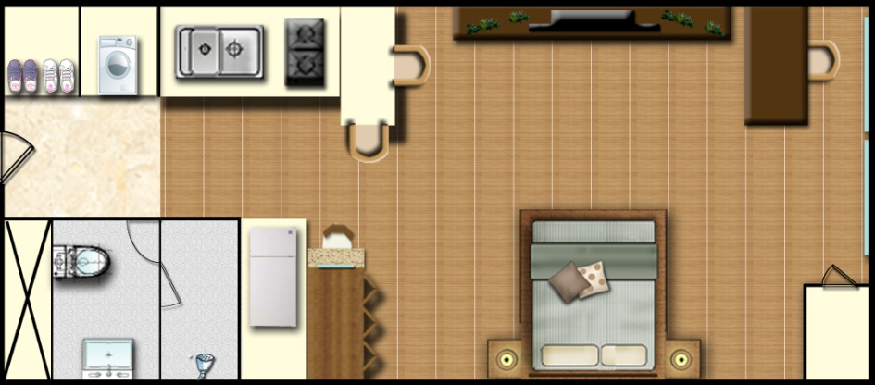
Cross-sectional Diagram
Studio Double (9,500 X3,600)
Studio Twin (9,500 X3,600)
708-16 Yeoksam-Dong Gangnam-Gu, Seoul, Korea (135-080) Tel: 02-6202-3100 Fax: 02-6202-3669 www.seoulresidence.co.kr

Slide 6
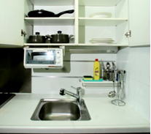
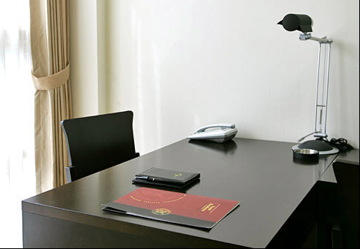
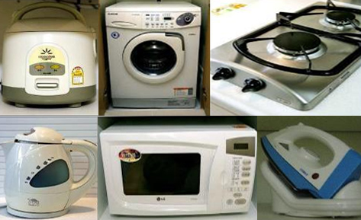
Amenities
Cable TV
Business desk
Air conditioner
Hair Dryer
Microwave
Kitchenware
Built-In refrigerator
Iron and board
Toaster
Electric Water Kettle
Drum Washing Machine
Free High Speed Internet
And more
708-16 Yeoksam-Dong Gangnam-Gu, Seoul, Korea (135-080) Tel: 02-6202-3100 Fax: 02-6202-3669 www.seoulresidence.co.kr

Slide 7

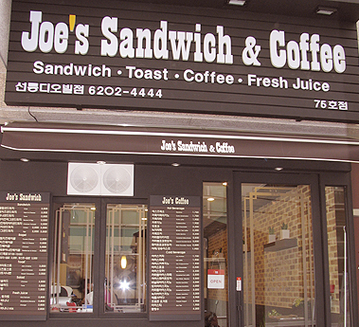
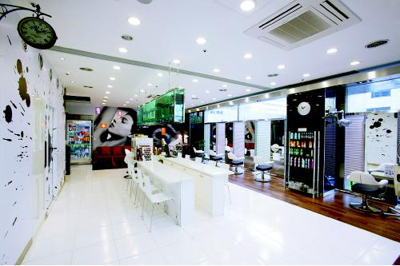
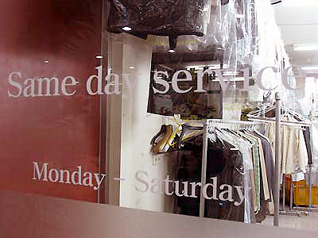
Facilities
Family Mart
24hours open convenience store
Joe’s Sandwich & Coffee
Offer breakfast and coffee
Nvague beauty salon
Hair styling and more.
Laundry shop
Dry cleaning, wash and everything for clothes.
708-16 Yeoksam-Dong Gangnam-Gu, Seoul, Korea (135-080) Tel: 02-6202-3100 Fax: 02-6202-3669 www.seoulresidence.co.kr

Slide 8
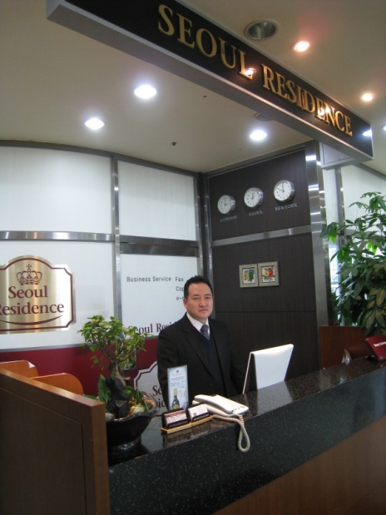
Services
24 hours reception service & security system
Room maid for clean
Wake-up call service
Free high speed internet
Free parking
Exchange of money service
Free shuttle bus (need a reservation)
708-16 Yeoksam-Dong Gangnam-Gu, Seoul, Korea (135-080) Tel: 02-6202-3100 Fax: 02-6202-3669 www.seoulresidence.co.kr

Slide 9

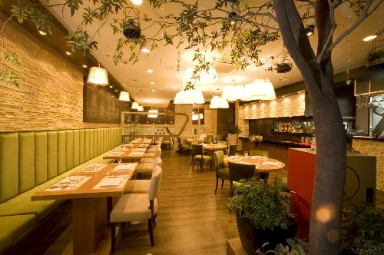
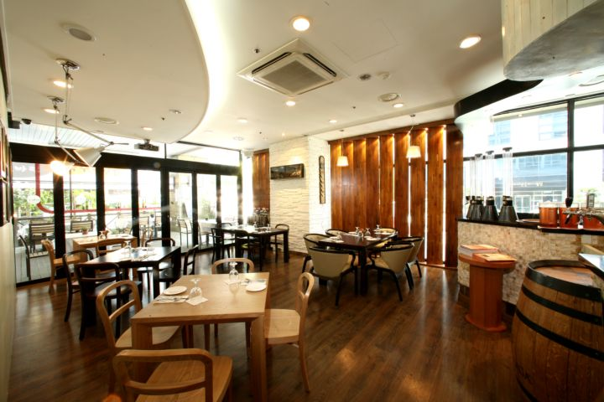
Il Piace (Italian Restaurant)
Il Piace offers diverse menu including traditional Italian pizza, pasta, steak, lamb chop, seafood dishes and maintains a large wine list.
Il Piace promises you an unforgettable dining experience with a high-quality taste and exceptional service.
Il Piace is located at the lobby level of Seoul Residence.
708-16 Yeoksam-Dong Gangnam-Gu, Seoul, Korea (135-080) Tel: 02-6202-3100 Fax: 02-6202-3669 www.seoulresidence.co.kr

Slide 10
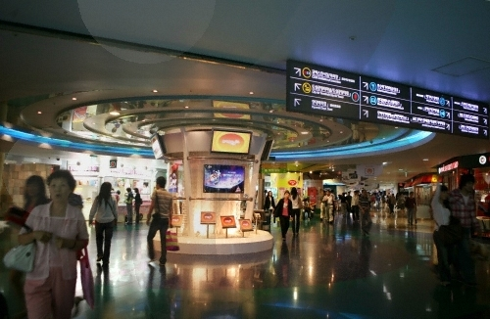
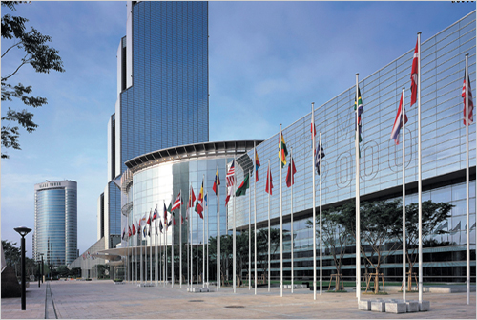
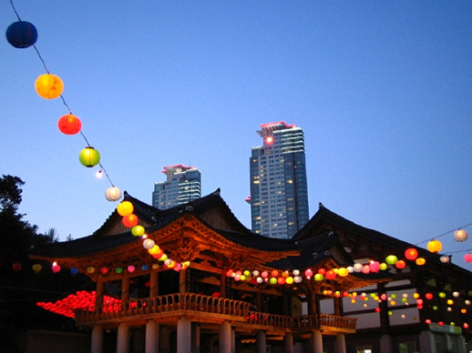
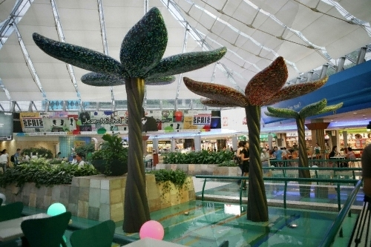
Attractions
COEX, ASSEM Tower, Trade Center
Taeheran Valley
Shopping street
Sunjungnung (Smnung Park)
Bongeun Temple
Hyundai department store
AK Duty free shop
708-16 Yeoksam-Dong Gangnam-Gu, Seoul, Korea (135-080) Tel: 02-6202-3100 Fax: 02-6202-3669 www.seoulresidence.co.kr

Slide 11
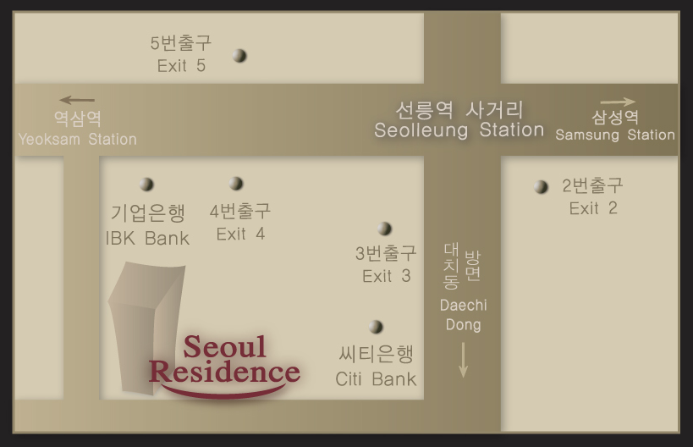
Location & Map
By Subway
Green Line 2, Yellow Bundang Line
Seolleung Station Exit 4 (Building located behind IBK Bank)
By Bus
Getting off : Seolleung Station / Jinsun High School
708-16 Yeoksam-Dong Gangnam-Gu, Seoul, Korea (135-080) Tel: 02-6202-3100 Fax: 02-6202-3669 www.seoulresidence.co.kr

